Slide 1
Immutability and Attacks on Bitcoin Blockchain

Slide 2
Bitcoin Proof of Work (PoW) System
Most implementations of Bitcoin PoW use double SHA256 hash function
The probability of getting a PoW is low – it is difficult to say which miner will be able to generate the block
– No miner will be able to control the bitcoin network single handedly

Slide 3
Tampering PoW Blockchain
Block 3
Prev_Hash Timestamp
Tx_Root Nonce
Block 4
Prev_Hash Timestamp
Tx_Root Nonce
Block 2
Prev_Hash | Timestamp
Tx_Root |  | Nonce
Curr_Hash
Curr_Hash
Curr_Hash
The blockchain together contain a large amount of work
The attacker needs to perform more work to tamper the blockchain
This is difficult with the current hardware

Slide 4
0000d30d9ef88225ea2ef6e08e934b62298e8d22fc300a1860ea96b79593c6b6
Cab2c839bc401f2f57754c604154f21f16c6090d003231ecd740bbdcbb616145
0000d85dbd4797296dffd52d7223426fafea5ca035a3a63db5373ad61a6f5fc8

Slide 5
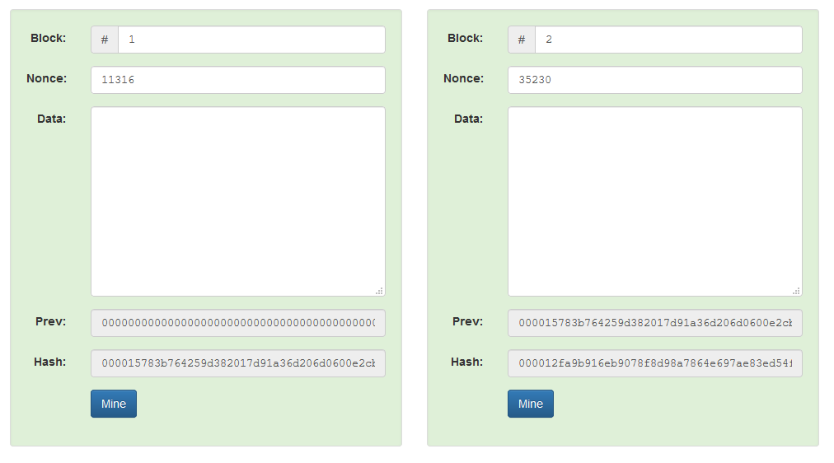
Demo

Slide 6
Sybil Attacks
Attacker attempts to fill the network with the clients under its control
Refuse to relay valid blocks
Relay only attacked blocks – can lead to double spending
Solution:
Diversify the connections – Bitcoin allows outbound connection to one IP per /16 (a.b.0.0) IP address

Slide 7
Denial of Service (DoS) Attacks
Send lot of data to a node – they will not be able to process normal Bitcoin transactions
Solutions:
No forwarding of orphaned blocks
No forwarding of double-spend transactions
No forwarding of same block or transactions
Disconnect a peer that sends too many messages
Restrict the block size to 1 MB

Slide 8
51% Attack
To perform a 51% attack on a blockchain, you need to control a majority of the hash rate
If they control a majority of the computing power, their chain (containing malicious blocks) will grow faster than the honest chain
Leads to double spending

Slide 9
The Monopoly Problem - PoW
PoW depends on the computing resources available to a miner
Miners having more resources have more probability to complete the work
Monopoly can increase over time
Miners will get less reward over time
Users will get discouraged to join as the miner
Few miners with large computing resources may get control over the network

Slide 10
Disadvantages of PoW
Monopoly Problem
Wastage of Processing Power of other Miners who did not succeed in Creating Block
Wastage of Electricity
Wastage of Time
Other Consensus Algorithms ???

